Slide 1
Creating a Vision and Planning for Employment and Community Life Engagement
OALICONLINE 2023
Staci Jones- ICI University of Massachusetts Boston
Lisa Wade- Utah Department of Health and Human Services
Bryn Peterson- Utah Department of Health and Human Services
Amy Huppi- ICI University of Massachusetts Boston
Notes:
Hi everyone, we are going to kick of this session, entitled: creating a vision and planning for employment and community life engagement. My name is Staci jones, I am a technical assistance and policy associate from the institute on community inclusion at the university of Massachusetts at Boston. I'm joined by 3 other colleagues today, each of whom will be introducing themselves as we move through our material today, and note that contact information and key hyperlinks are included in the presenter handout in the conference platform.

Slide 2
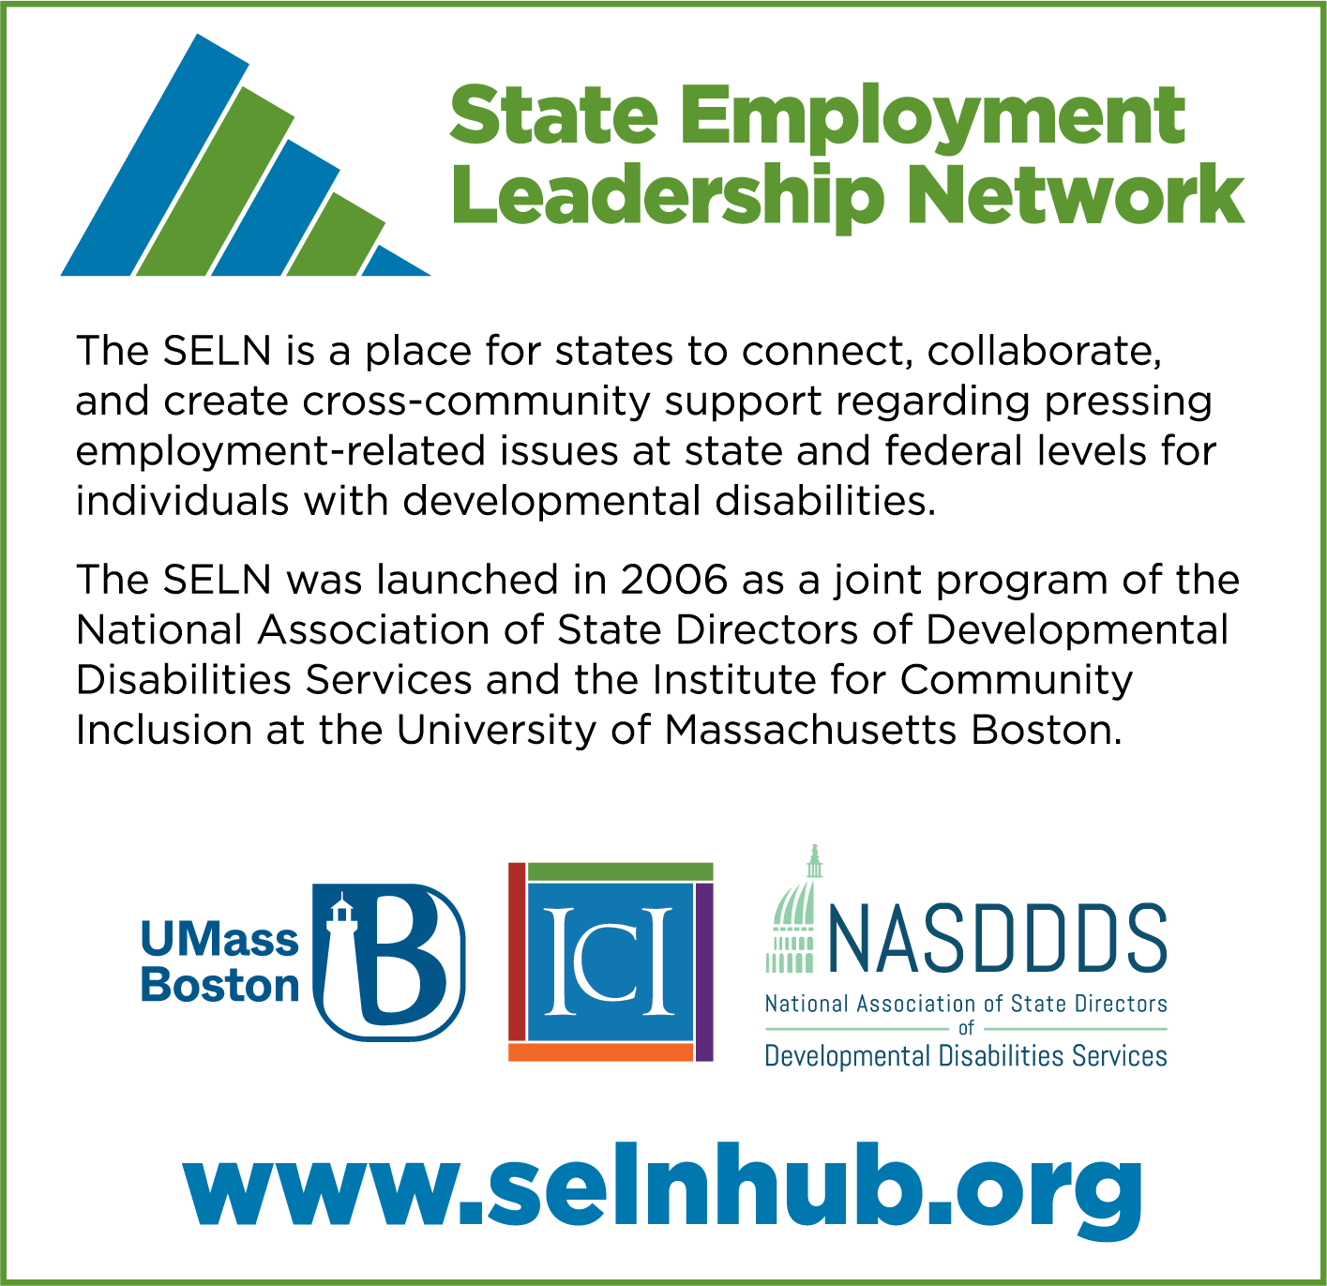
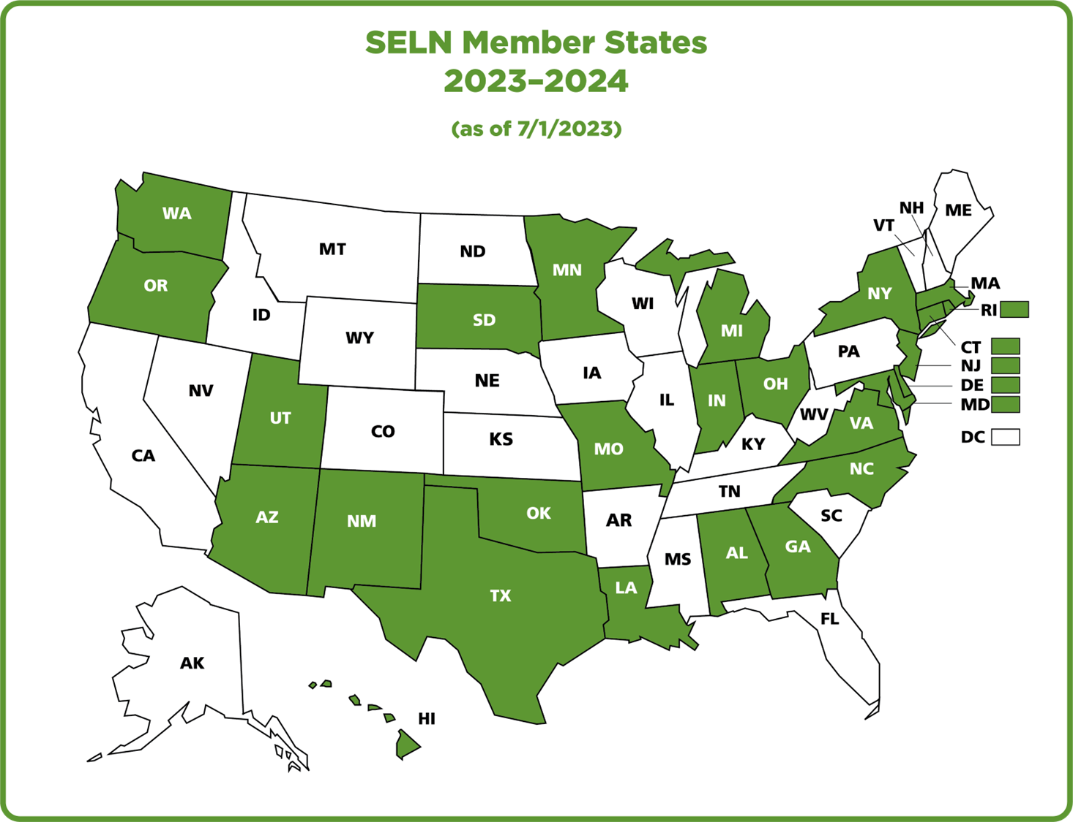
Notes:
I, along with the other colleagues joining me for today's presentation, are part of what is called the state employment leadership network or the SELN. For those that are not familiar, the SELN is a membership organization made of state intellectual and developmental disabilities agencies across the country. The SELN was launched back in 2006 and is a joint project between ICI Umass Boston as well as the National Association of State Directors of Developmental Disabilities Services (or NASDDDS), There are currently 26 SELN states, and I am sharing on my screen a map of the united states and the current SELN member states are highlighted in green. The SELN provides a way for states to connect and collaborate regarding employment related issues (at state and federal levels) for individuals with developmental disabilities. Today we are joined by staff from the state of Utah who will be sharing some of their perspectives and tool and you will meet them a little later on. If you'd like to read more about the SELN and what's happening in our member states you can go to www.SELNhub.org

Slide 3
Quick Poll: Who is here today?
Person with a disability
Family
State agency
Service provider
Case manager
Education/transition
Other
Notes:
But, before we move through our presentation we want to take a quick poll to see who has joined today. When the poll pops onto your screen just pick the role that most closely describes you. And if your role isn't represented, feel free to click other. Options in the poll include: person with a disability, family member, state agency, service provider, case manager, education /transition or other. And as we get started here, please feel free to post an introduction in the chat of where you are from and what your roll is.

Slide 4
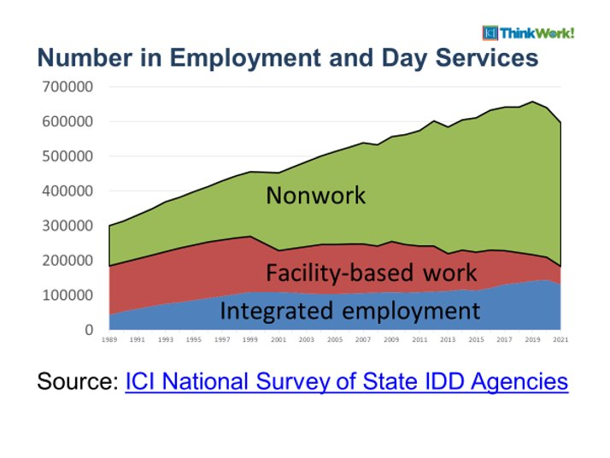
Number in Employment and Day services 1989 through 2021
Most people are here!
So, what are we doing?
www.statedata.info
Notes:
Now to set the stage, I want to quickly share a few data points that provide some context to the resources my colleagues will be sharing related to supporting pathways to employment. On my screen I am sharing a graph that highlights data from the ICI national survey of state intellectual and developmental disabilities agencies starting all the way back in 1989 all the way through 2021. This data shows clearly in this green section that the largest and fastest growing category of people receiving funded employment and/or day services is in this nonwork category. And while we can see that integrated employment has continued to grow over the years and that facility based work has continued to decrease, far and away what we're seeing is this immense growth in the category of non-work day services. Just a quick note that you can find out more about the national data survey and all kinds of other employment related data at statedata.info

Slide 5
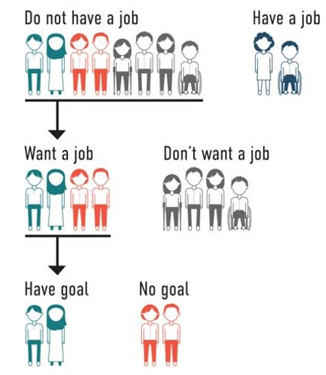
What does the Data say?
86% Don’t have a job
51% Want a job
37% Have a goal in their plan
https://www.nationalcoreindicators.org/2020-2021
Notes:
Keeping that last data in mind I now want to share the most recent national core indicator data from 2021 (and you can find this data at nationalcoreindicators.org), this data shows that out of individuals with disabilities surveyed, 86% reported not having a job. Out of that 86%, 51% of people reported WANTING a job. And perhaps the most critical piece of data here is that only 37% report having an employment goal in their current person centered service plans. So we can see from this data the discrepancy between what people report wanting in their lives vs what might end up in their service plan.

Slide 6

Individualize supports for each person
1
Promote community membership and contribution
2
Facilitate relationships and skill building to reduce reliance on paid supports
3
Ensure that supports are outcome oriented and regularly monitored
4
Community Life Engagement
Guideposts
Notes:
Both of those pieces of data highlight the importance of shining a light on what is happening in that nonwork category of services. ICI umass boston has research and resources related to the importance of supporting community life engagement. And Community Life Engagement essentially includes all the ways that people with disabilities access typical community settings and services when they are not working, including things like volunteerism, post secondary or continuing education, accessing community facilities such as a local library, gym, or recreation center; participation in retirement or senior activities; and anything else people with and without disabilities do in their off-work time. Community life engagement may also support some level of career exploration for those that are not yet working or people that are between jobs. Just like for all of us, community life engagement can could supplement employment hours for people working part- time, or serve as a retirement option for older adults. Here on the screen are what are known as the 4 guideposts of community life engagement. These guideposts emerged from research at ICI Umass and basically establish a set of quality indicators for states and provider organizations to consider when building out their services that may support Community Life Engagement. The guideposts include individualizing supports for each person, promotion of community membership and contribution, the building of relationships and skills in order to reduce reliance on paid supports and ensuring supports are outcome orientated and regularly monitored.

Slide 7
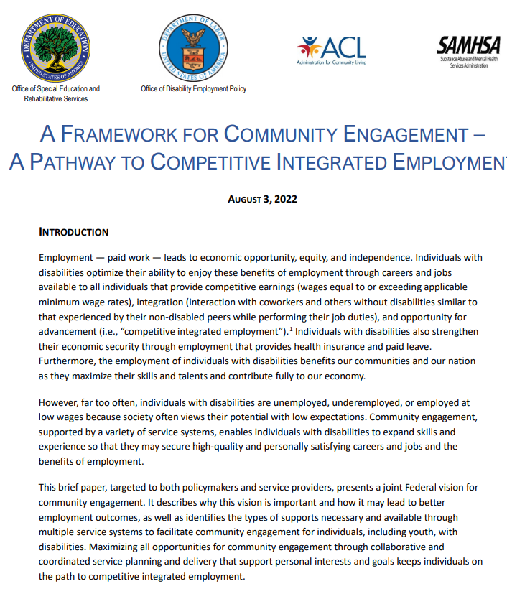
A Framework for Community Engagement – A Pathway to Competitive Integrated Employment
Notes:
And finally, I want to highlight one last thing, which is a joint brief that was drafted by the office of special education and rehabiitative services, the office of disability employment policy, the administration for community living and the substance abuse and mental health services administration...and there is a link to this brief in our presenter handout if you'd like to read it. But what I want to point out is that this brief, acknowledges that people with disabilities continue to be unemployed, under employed and employed at low wages and that meaningful community engagement may lead to better employment outcomes. And there is one quote in particular I want to draw your attention to: "Maximizing all opportunities for community engagement through collaborative and coordinated service planning and delivery, that support personal interests and goals, keeps individuals on the path to competitive integrated employment." This is important to keep in mind while also considering the data I just shared about the growth of non-work services. I'm now going to pass things off to my colleague Amy Huppi to talk about the important role of case managers in supporting a pathway to employment and community life.

Slide 8



Role of Case Managers in Employment
Support development of a vision for employment and a plan to get there
Link to supports and services
Ensure team collaboration and communication
Notes:
Amy- Case Management and eLearning

Slide 9

Pathways to Employment
Not interested in work
Interested in work
Working and focused on career growth

Slide 10
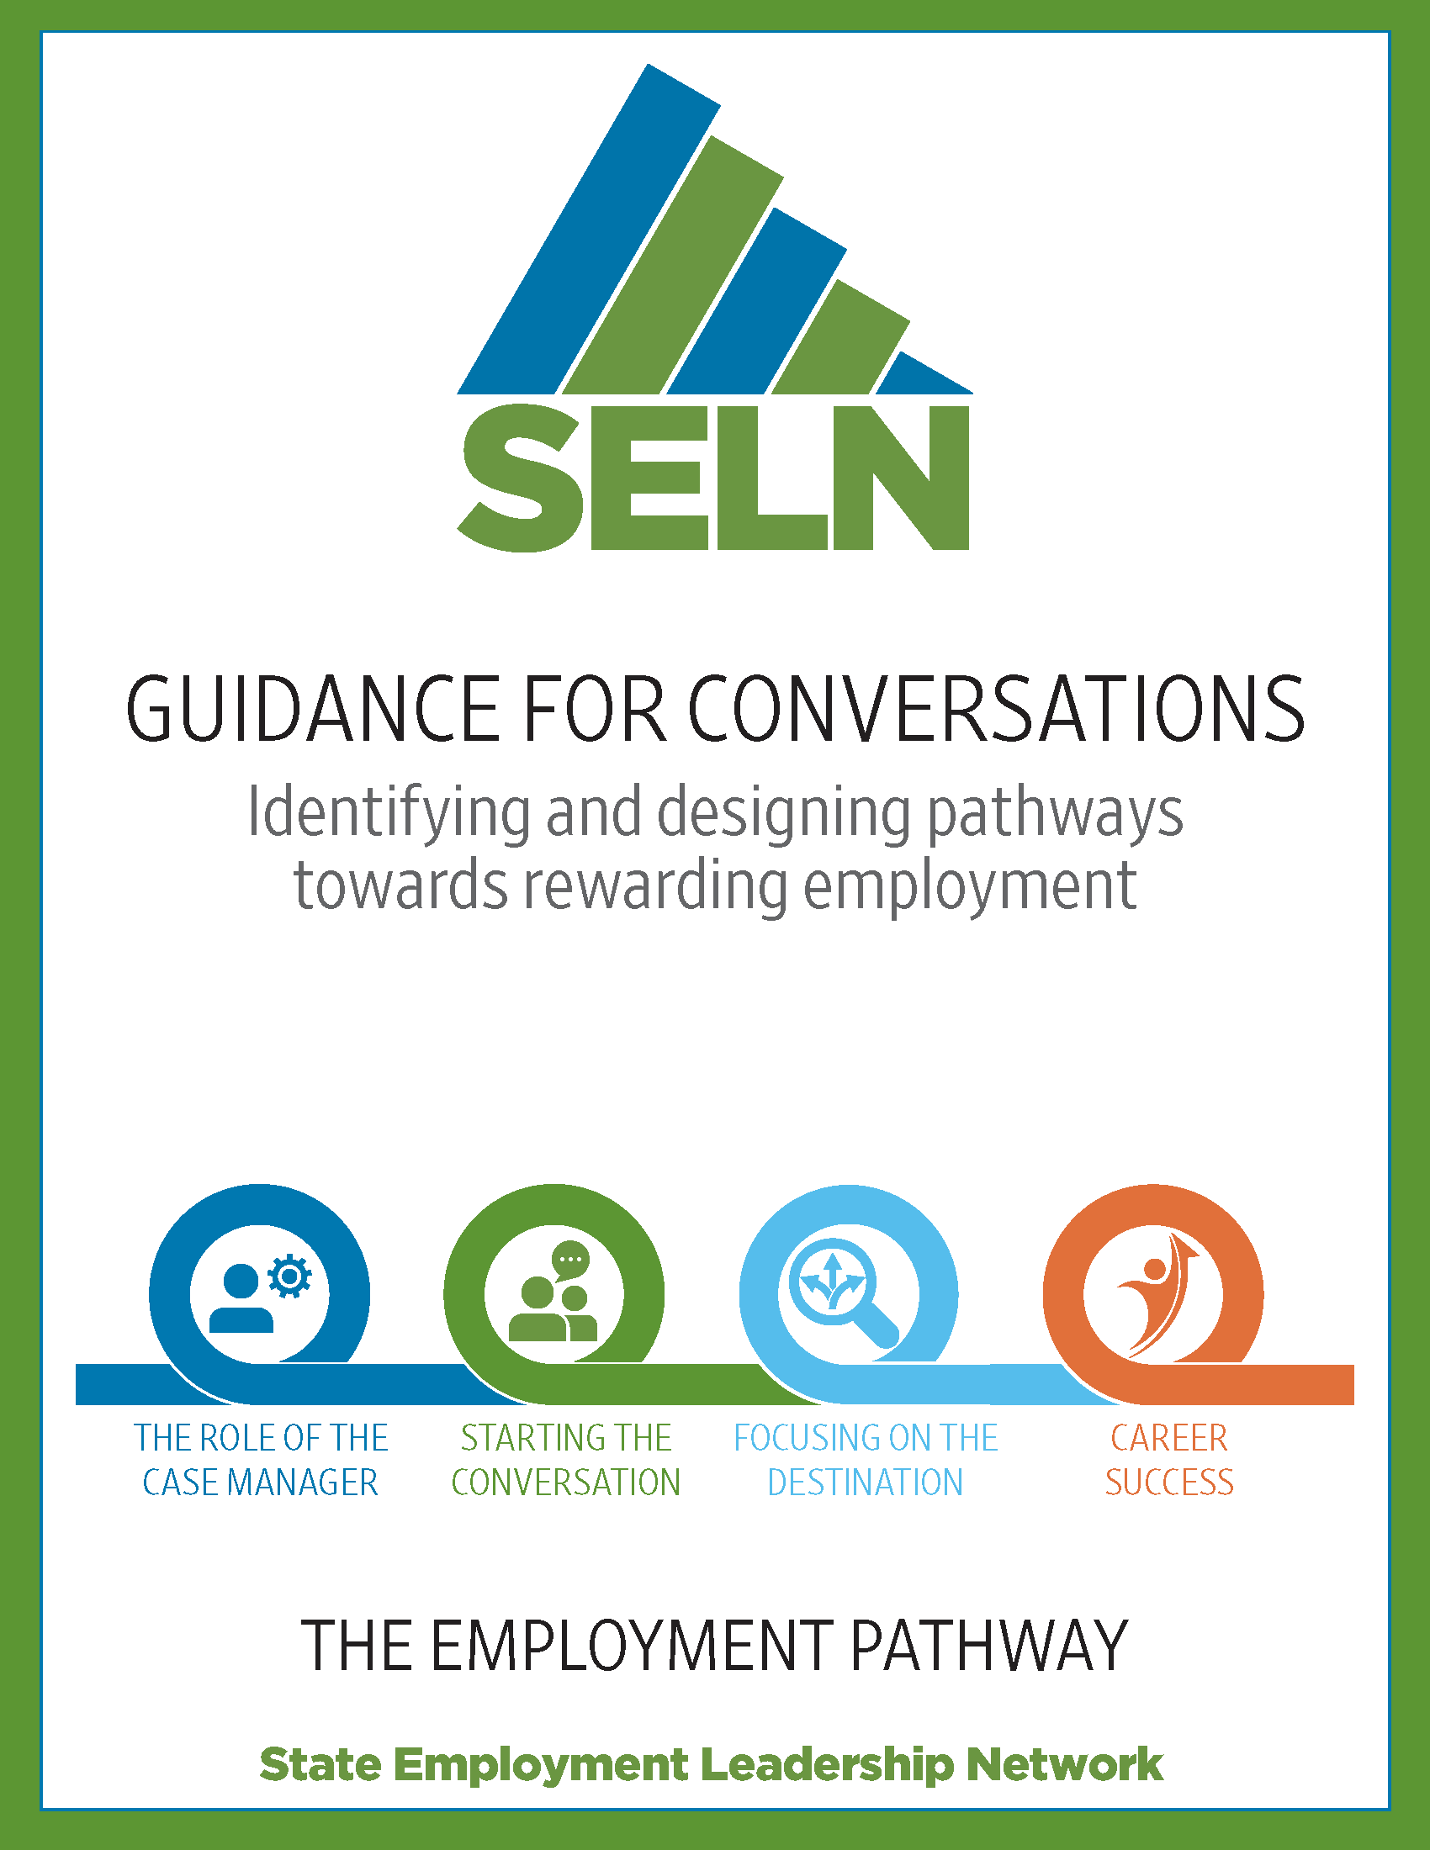

Support for Case Managers
Supporting a Vision for Employment

Slide 11

Employment First Priority
Department of Workforce Services
Utah State Office of Rehabilitation
Division of Services for People with Disabilities
Office of Substance Use and Mental Health
“When providing services to a person with a disability, give priority to providing services that assist the person in obtaining and retaining meaningful and gainful Employment”
62A-5-103.3: Employment first emphasis on the provision of services.”

Slide 12
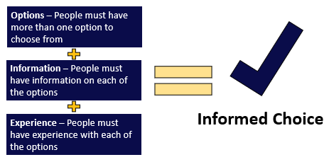
Informed choice
Guided conversations should:
Gain perspective from the person’s point of view.
Broaden the person’s understanding of options, information, and experiences to develop informed choice.
Help the person develop professional abilities and build social connections through their experiences.
Be sensitive to the unique needs of the person and communicate in a way that the person understands.
Notes:
The information on this slide is taken directly from the employment pathway tool section describing the design. That section describes in full how the tool is organized, starting with these statements and graphic. The intention there was not to lose sight of the purpose of providing the opportunity for employment by ensuring every working age person, from age 14-65, has exposure to the options available to them for competitive and integrated employment, the current information connected to potential options, and some hands-on experiences to make a decision about working. We also included some reminders for case managers and others leading the conversation about what should be accomplished as a result of the conversation. Informed choice is at the core of this tool. We use this informed choice graphic in a lot of our resources to emphasize the importance of and what makes up an informed choice.
AND/OR
The Pathway Tool was published for Utah’s Disability Services system to make sure informed choice was individual, person-centered, and current, and that the resources available were being used effectively to educate and provide exposure to what competitive integrated employment could look like, one person at a time. We want to do more than just to check the box for informed choice. We provide weekly technical assistance on how the tool can help the full support team to have person-centered conversations, be flexible when a person does not communicate verbally, and how to connect a conversation with a hands-on experience, reminding providers that the conversation alone - or just providing information - is not full informed choice.

Slide 13
Employment Pathway Tool Research
References:
Reviewed similar resources from other states for (PA, SD, OR, etc)
SELN Guidance for Conversations
Charting the Life Course (CtLC)
Existing DSPD person-centered planning guidance and tools
Notes:
The DSPD Employment Pathway Tool is meant to provide a facilitator with a guided conversation to support a person to reach informed choice for employment. In Utah, each case manager or support coordinator is required to hold an informed choice conversation for employment at least annually. We heard from different sources that this annual conversation about employment, was typically one question, do you want to work? We recognized that one question was not enough for a person to really understand their potential for employment and that a tool was needed to make that conversation much more robust. As we prepared for what a Utah specific resource for those conversations could look like, we leaned on the resources listed here. Similar guided conversation tools and resources are available in other states, we leaned heavily on content from Pennsylvania, South Dakota, Oregon and others. We also reference the State Employment Leadership Network or SELN’s Guidance for Conversations document. Utah has been an SELN member for 3 years; they provided technical assistance and support as we worked through each phase of this project. We also reference Charting the Life Course's person-centered planning tools and approach. We are in the process in Utah of embedding Charting the Life Course (CtLC) practices into all our person-centered planning. The DSPD Employment Pathway Tool represents just one document or resource being implemented to help a person to be included and integrated in their community through work and other interests. Last, we reviewed some of the previously developed internal resources to ensure alignment between existing documents and the Employment Pathway Tool.

Slide 14
Preparation and Pilot
About 6 months of brainstorming and drafting
Engagement and feedback with stakeholders throughout
  People and families in services
  Providers and Support Coordinators
  Disability Law Center
  Utah Parent Center
  Utah State University Center for Employment and Inclusion
  Utah State Office of Rehabilitation
3 phase pilot project
  10 people in HCBS services
  1-2 cases per month
  3-month pilot
Notes:
SLIDE 4: Our team spent about 6 months brainstorming and created several different drafts of the tool to make sure it included all the right information and not a smidge more. This was challenging to say the least. We had a lot of great help from our many partners who we engaged with throughout this process. They reviewed and gave feedback on the tool as part of a workgroup we developed to enhance our person-centered support plans. We also had many direct discussions with Vocational Rehabilitation to make sure all references to their services were both accurate and helpful.
Next we wanted to provide you with a breakdown of how Utah went about testing the DSPD Employment Pathway Tool. We started by asking for volunteers from our contracted case managers to help us. We started the pilot with about 10 people. This was during the pandemic, so by the end we had about 5 consistently testing the tool with willing participants on their caseloads. Some DSPD state staff also completed a guided conversation to test the tool. Each case manager was asked to find 1 or 2 people to complete the tool with each month. After using the tool, they completed a feedback form and attended a short debrief. We treated each round or month as a phase, only focusing our feedback on one section at a time. We started by having the group identify if they thought the tool was user friendly and easy to follow. The next phase was to identify if the questions under each pathway they chose were useful or helpful. The final phase was to determine what suggested next steps were most useful or helpful. Between each phase we made edits and adjustments to the tool. All of this feedback was gathered from the pdf version we offered in the link. After we had gathered that feedback and made edits, some talented DSPD developers helped us create an electronic version, which a few support coordinators also tested. We want to say thank you publicly to all the people who helped us on this project, the next slides are just a few comments sent in on the tool.
COMMENTS and FEEDBACK
“The questions were centered around helping our client to make the best informed decision regarding his employment desires. He has been kind of all over the board on what he wants, and the questions help us to get a clearer picture of what would be a good fit for him at this point in his life.”
“I was very impressed by this tool, and the way that it opened up our client to being able to lead the meeting into a place where he was able to let us know what he likes, and what he dislikes in an employment pathway.”
“The individual really enjoyed the attention and being able to talk about his desires and possibilities including studying for his permit.”
“Yes, it is a common sense approach to employment.”
This is a sample of some of the comments we received. In general the feedback was to add or repeat some frequently used questions in all the pathways, that the tool was easier the more familiar it became, and that the tool should be more responsive to some unique situations and circumstances. We will cover that last one at the end.
Generally though the feedback is encouraging: “the questions help us to get a clearer picture of what would be a good fit for him at this point in his life”... the person was “able to lead the meeting into a place where he was able to let us know what he likes, and what he dislikes..” And that “it is a common sense approach to employment.”

Slide 15
Overview of the DSPD Employment Pathway Tool
Value of employment
Purpose of DSPD Employment Pathway Tool
Section 1: Identifying the employment pathway
  Appendix A
Section 2: Exploring Pathway A, B, C, or D
Section 3: Develop the services and supports
DSPD Employment Pathway Tool

Slide 16
Identify the pathway
Employment pathways
The person is unemployed and expresses interest in work.
The person is unemployed and expresses they do not want to work right now.
The person is working, but desires a change.
The person would like to maintain their position and continue to grow in their career.
Notes:
Lisa and Bryn
Tools used in Utah to support pathways to employment

Slide 17
Employment conversation exercise
Pathway A suggestions:
Q: How will things change when you start working?
Q: What opportunities have you had for work experience?
Q: What type of job do you see yourself doing?
Pathway D suggestions:
Q: Tell me about the things you are good at?
Q: What is the best part of your job?
Q: Are there new tasks or responsibilities you would like to try?
Notes:
There are some hard copies of the tools we will show you today. You can look at those if you have one …..or follow the links in the previous slide……….. Due to the size of the groups in this presentation we can’t break into an activity so this has shifted into a thought exercise…..
For this exercise, refer to the Pathway Tool Response Page……… and Pathway A and Pathway D………. Next think about who you might want to complete the tool for…… So you might complete this exercise for yourself………with you as the subject……… maybe a family member……… or someone you know on your caseload, or another person….. but think of a person, and on the screen you will see a couple prepared pathway tool questions to answer.
We don’t know where all of you are in your career at this point……. so we are the limiting choice in this exercise between 2 options…. Pathway A….. which as a reminder is a person who wants a job, but currently is unemployed…….. or Pathway D a person who is satisfied with their job and wants to continue in their career…. Knowing the options might give you a better idea of who to choose as the subject for this exercise ….. Choose the pathway and answer the corresponding questions on the screen in your notes……. in the response page……. on your device…….. or just in your mind. We purposefully chose both of these Pathways options for this presentation…..Pathway A to show how we have that conversation when someone is interested in work, how we connect them with resources and to meaningful experiences that lead toward an eventual job…. and Pathway D because we were pretty certain, if you choose yourself as the subject of this activity……it was safer to assume all of you are satisfied with your current jobs… since you might be sitting next to your coworkers… or a supervisor right now! The next example we will give will also cover a path for a person who is stating they are not interested in work right now.

Slide 18
Pathway Tool application
Develop a Plan
Pathways A and B
  What informed choice activities for employment have you completed over the past year?
  What is your plan for new informed choice activities this year?
Person centered planning next steps
Vocational Rehabilitation next steps
If not work, then what makes a meaningful life?
Notes:
Section 3 of the Employment Pathway Tool - Develop a plan.
This is the place to develop the Services and Supports in the Individual’s Person-Centered Support Plan for the identified Pathway.
Documentation in this section should identify employment goals and activities to meet the “experience” element of informed choice for employment, especially for Pathways A and B. Multiple activities should occur at various times within a plan year. Case managers should use this section to track places visited and the person’s response to each place. They should outline the places, activities, and experiences the person wants to have in the upcoming year. This serves as a running record of what has or has not interested the person, and provides evidence of informed choice around employment.
When the persons’ vocational interests change, informed choice activities should change to align with the new interest. If no interests are identified at that time, different experiences should be identified and planned for the future.
Documentation should also outline a plan for how Vocational Rehabilitation and DSPD services will be utilized, through person-centered planning (PCP) to support the person to reach individual employment goals.
An important element is to look at the alternatives for what a person wants to do for a meaningful life if they don’t want to work.

Slide 19
“Develop a plan” exercise
Pathway A suggestions:
Use person-centered planning tools to inform job goals and activities.
Build skills that easily translate to a worksite.
Network with family and others to seek out job shadowing opportunities.
Pathway D suggestions:
Update work-based goals and review all existing supports.
Discuss opportunities to increase wages or hours.
Meet with a benefits specialist.
Be evaluated for assistive technology.
Notes:
There are some hard copies of the tools we will show you today. You can look at those if you have one …..or follow the links in the previous slide……….. Due to the size of the groups in this presentation we can’t break into an activity so this has shifted into a thought exercise…..
For this exercise, refer to the Pathway Tool Response Page……… and Pathway A and Pathway D………. Next think about who you might want to complete the tool for…… So you might complete this exercise for yourself………with you as the subject……… maybe a family member……… or someone you know on your caseload, or another person….. but think of a person, and on the screen you will see a couple prepared pathway tool questions to answer.
We don’t know where all of you are in your career at this point……. so we are the limiting choice in this exercise between 2 options…. Pathway A….. which as a reminder is a person who wants a job, but currently is unemployed…….. or Pathway D a person who is satisfied with their job and wants to continue in their career…. Knowing the options might give you a better idea of who to choose as the subject for this exercise ….. Choose the pathway and answer the corresponding questions on the screen in your notes……. in the response page……. on your device…….. or just in your mind. We purposefully chose both of these Pathways options for this presentation…..Pathway A to show how we have that conversation when someone is interested in work, how we connect them with resources and to meaningful experiences that lead toward an eventual job…. and Pathway D because we were pretty certain, if you choose yourself as the subject of this activity……it was safer to assume all of you are satisfied with your current jobs… since you might be sitting next to your coworkers… or a supervisor right now! The next example we will give will also cover a path for a person who is stating they are not interested in work right now.

Slide 20
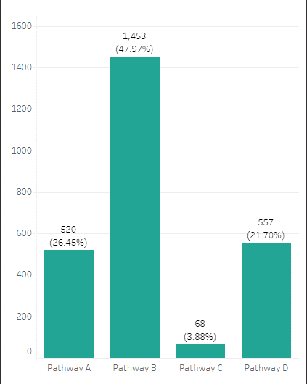
Employment Pathway Tool
Working age adults (in services)
6,580
Active Employment Pathway Tool
2,598
Percent with Tool
39%
Notes:
Lisa and Bryn
Tools used in Utah to support pathways to employment
Not in contract yet but we still encourage usage
NCI data - Would like a paid job in the community 54%
EPT 26.45% of those with a Tool

Slide 21

Questions?
Notes:
Thank you Bryn and Lisa for highlighting the tools and strategies you all are using in Utah to support pathways to employment. We are going to pause to answer any questions you all may have.

Slide 22
Contact Information
Amy Huppi Amy.Huppi@umb.edu
Bryn Peterson BrynPeterson@utah.gov
Lisa Wade Lwade@utah.gov
Staci Jones Staci.Jones@umb.edu
Notes:
Before we end, we want to be sure and share our contact information. These email addresses, along with links to the resources that were highlighted in this presentation can be found in our presenter handout in the conference platform. We thank you all for participating in this session. We hope that we’ve provided additional considerations for how to support pathways to employment beyond only focusing on the delivery of employment services, but also focusing on what’s happening in non-work services and how case managers are trained and supported in this area. Thank you to the state of Utah for sharing the tools and resources they have developed to this initiative.

